Slide 1

SCG & GCG - Heart Diseases
Sagar Panwar

Slide 2
Loading and plotting of Data
Extracted file paths from a directory structure and Associate them with labels.
Load the data where each row represents a file and folder name as a label.
Extracted the shape of the DataFrame (number of rows and columns)
Plot signals for accX ,accY,accZ against time

Slide 3
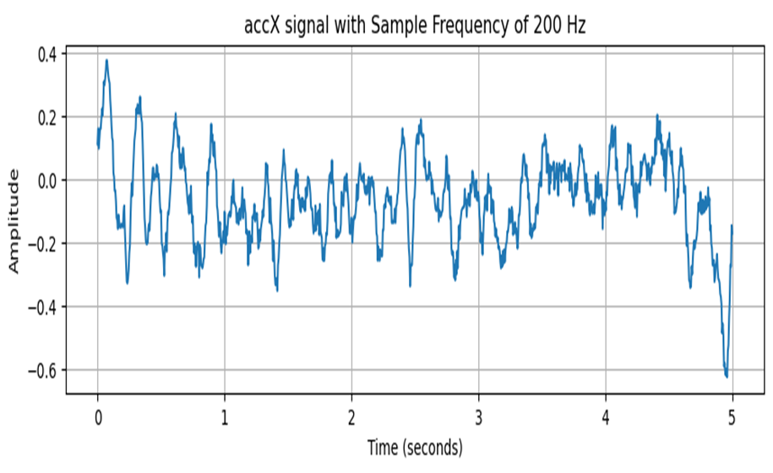
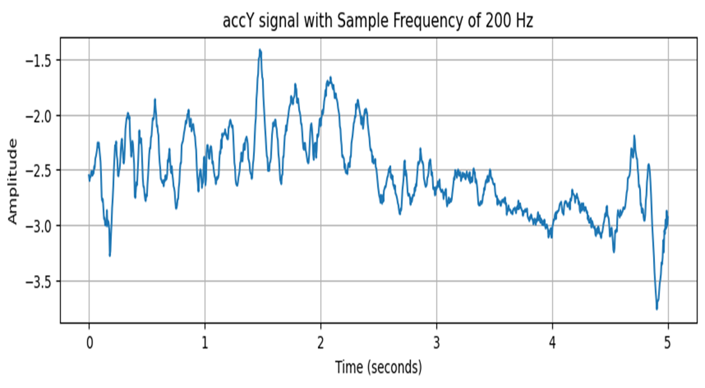
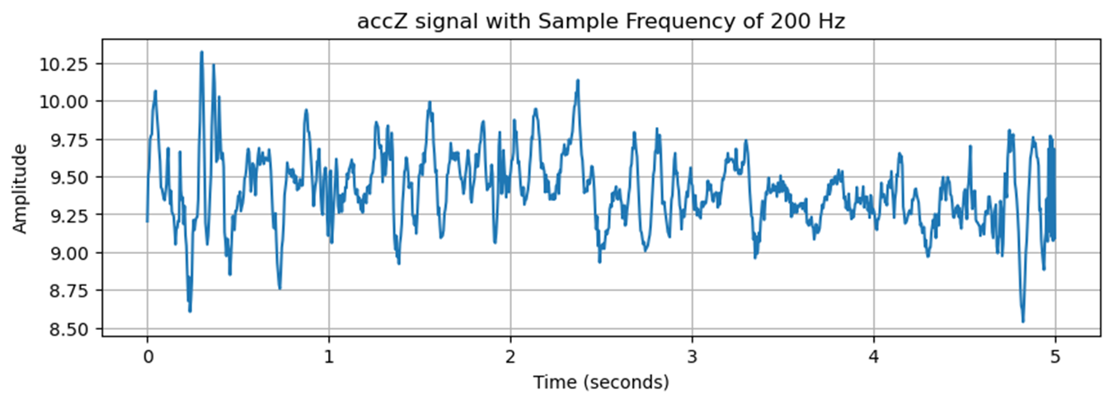

Slide 4
DFT
Conversion of a discrete sequence of time-domain samples into its equivalent frequency-domain representation.
It allowed us to analyze the frequency component of a signal by decomposing it into its constituent sinusoidal components.
We Performed frequency domain analysis on accX ,accY and accZ signal
Calculated the frequency spectrum by using FFT
Remove the freq outside the range (below 0.5 and above 20Hz)
Plotted magnitude spectrum which helps us to analyze the dominant frequency component within the signal

Slide 5
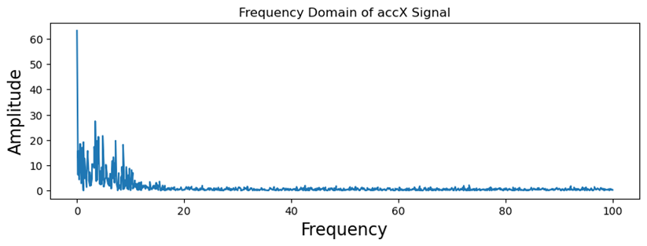
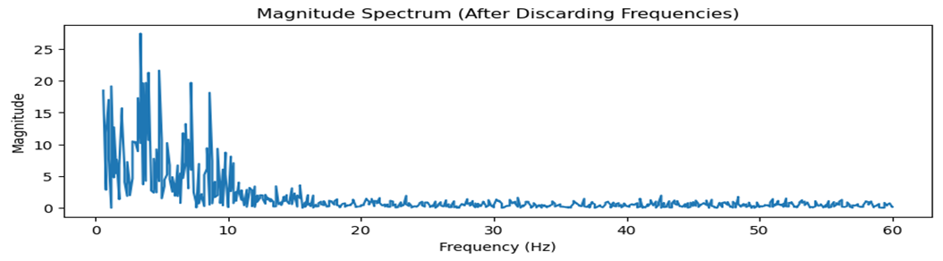
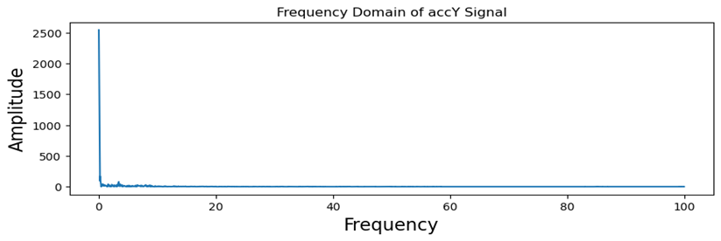
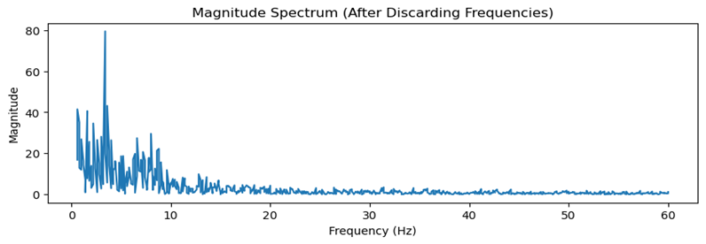
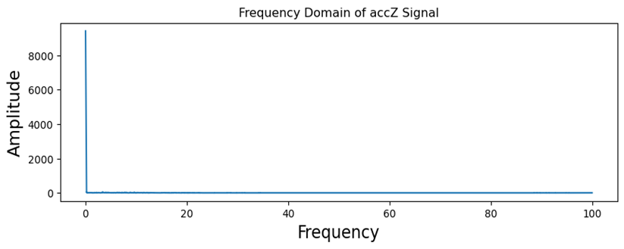
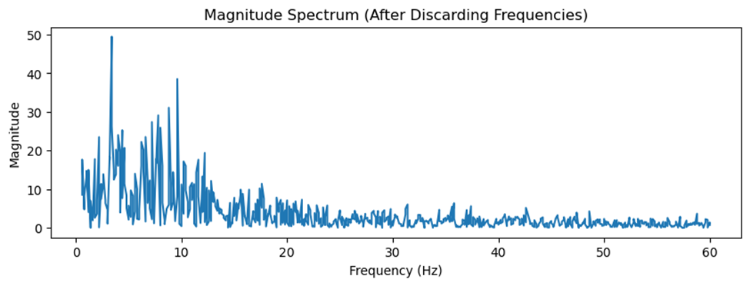

Slide 6
Filtering and Plotting
By the above analysis we designed Band pass filter
defined a function to filter accelerometer data using a Butterworth filter
Applied this filter to each entry in a DataFrame containing raw accelerometer data.
The Butterworth filter smooths out the frequencies we want to keep (passband) without creating wavy or bumpy distortions.
After filtering we observed that signals are much more clear as compared to raw input data

Slide 7
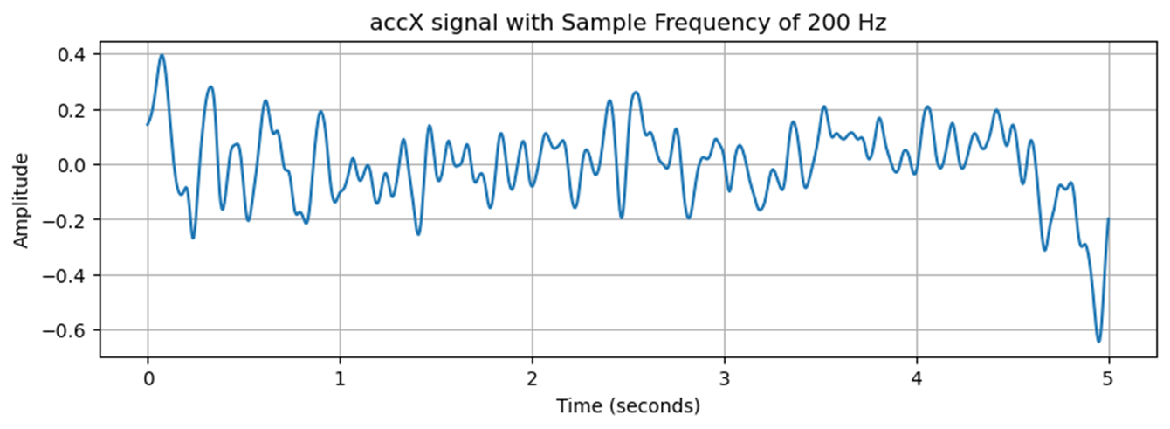
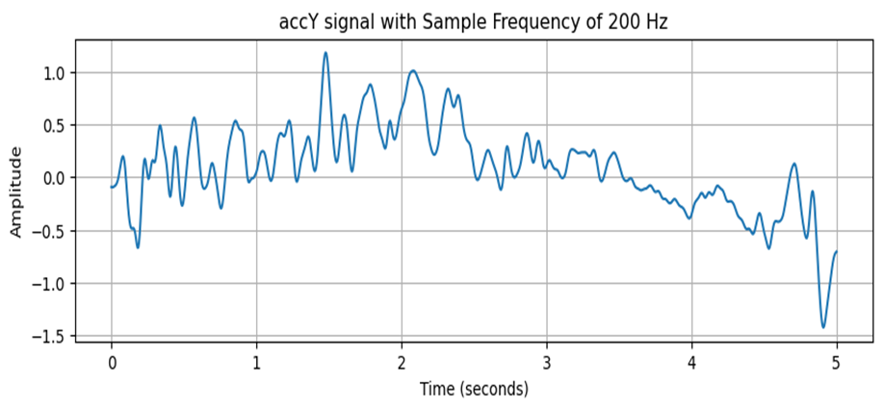
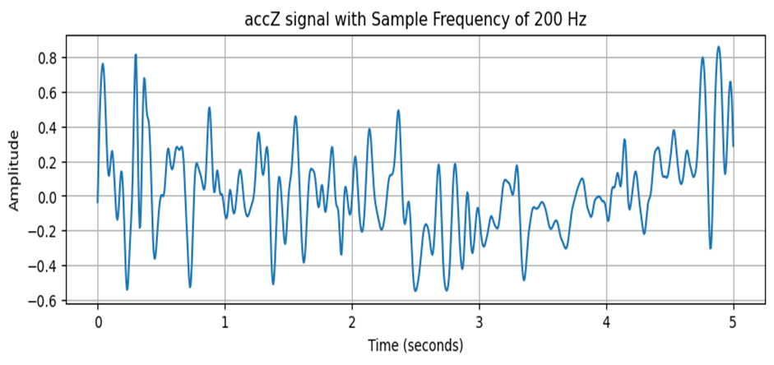

Slide 8
Comparison

Slide 9
Feature Extraction
Extracts both time-domain and frequency-domain features from accelerometer signals
Organized them into a DataFrame for further analysis.
For Example Absolute Energy,RMS value,Median Value ,Standard Deviation Kurtosis ,skewness ,spectral entropy and power band
These features gives various information about the signals such as their energy, distribution, and frequency content, which can be useful for further analysis

Slide 10
PCA and Plotting
Different types of activities or labels in our accelerometer data are Breathing_ normal,Breathing_ deep,Breathing _speaking , Not_connected
we used PCA, a technique that takes our complex data and turns it into a simpler form while keeping the important information.
we plotted it on a graph. Each point on the graph represents one set of accelerometer readings
As we plotted 2 principal component with the labels, We clearly observe that Breathing_speaking and Not_connected are very unique other than other labels. Whereas Breathing_normal and Brething_deep are very near and little hard to distinguish apart.

Slide 11
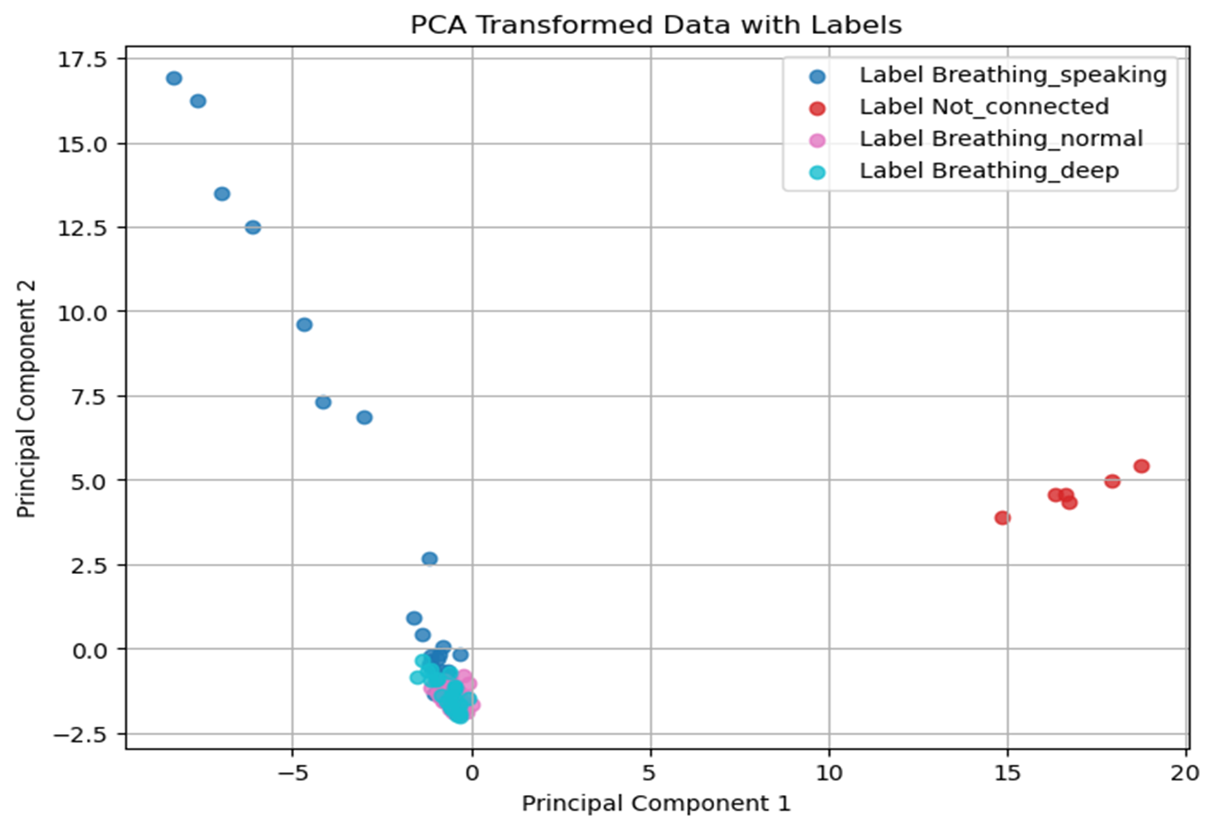

Slide 12
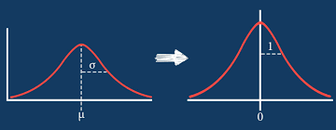
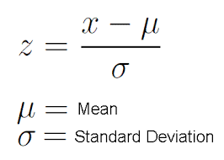
Standardization
Rescales data to have a mean of 0 and standard deviation of 1.
Brings features onto the same scale, aiding model convergence.
Maintains original data distribution while adjusting scale.
Reduce sensitivity to outliers.
Improves performance, particularly for distance-based algorithms.

Slide 13
KNN Classifier
-
-
-
-
-
-
-
-
-
-
-
-
-
-
-
-
-
-
-
+
-
+
-
+
-
+
-
+
-
+
-
x
-
x
-
x
+
+
+
+
+
+
+
+
+
+
+
+
(a) 1-nearest neighbor
(b) 2-nearest neighbor
(c) 3-nearest neighbor
Test data ‘X’ will be classified as it’s immediate neighbor
If no requirement is specified, nearest neighbor will be used. This selection criteria is also called as weighted distance
In this case, majority votes will be considered. Note that in case of equal (even) number of neighbors, tie may occur.
In case of tie, either nearest neighbors with shortest weighted distance will be considered, or selection will be done on specified requirements
The k-nearest neighbors of an instance ‘x’ are defined as the data points having the ‘k‘ smallest distances to ‘x’

Slide 14
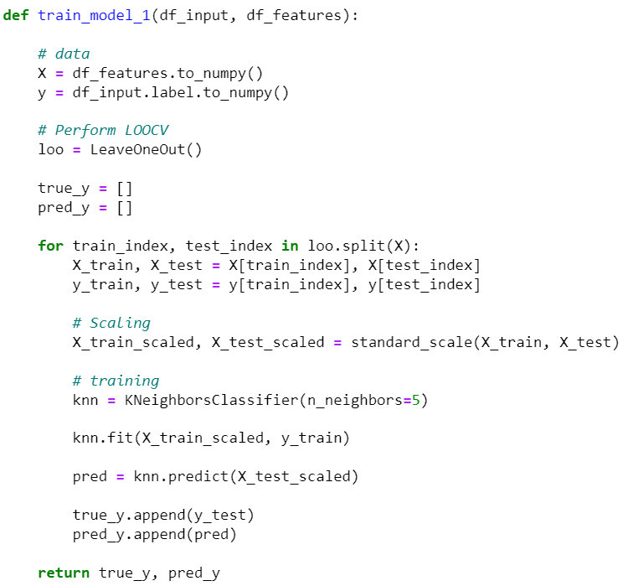
Model training functions
KNN Classifier
X & y, representing input features & target labels, are converted into numpy array.
LeaveOneOut is used for leave-one-out cross-validation (LOOCV) - a procedure used to estimate the performance of a machine learning algorithm when making predictions on data not used during the training of the model.
true_y and pred_y are lists to store the true labels and predicted labels during each iteration of LOOCV.

Slide 15
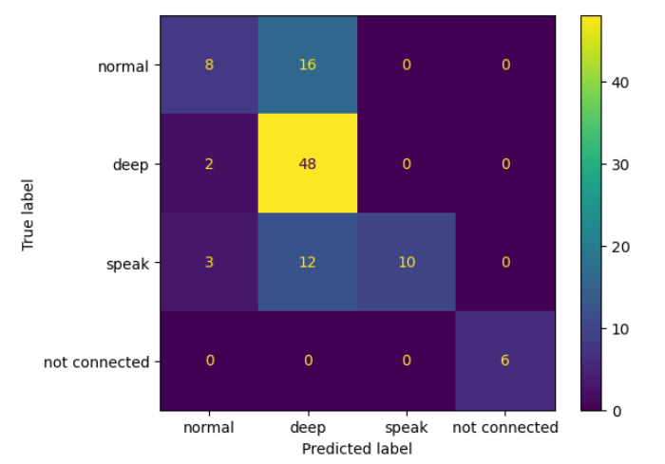
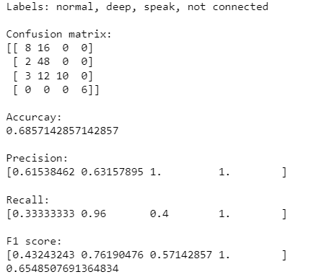
Model training functions
KNN Classifier - Results

Slide 16
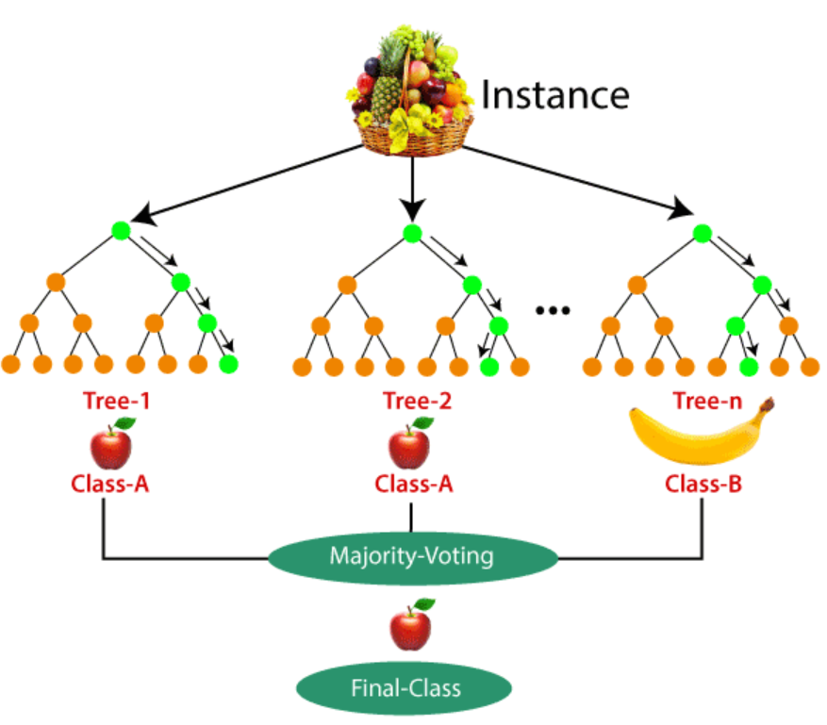
Random Forest Classifier
It takes less training time as compared to other algorithms.
It predicts output with high accuracy, even for the large dataset it runs efficiently.
It can also maintain accuracy when a large proportion of data is missing.

Slide 17
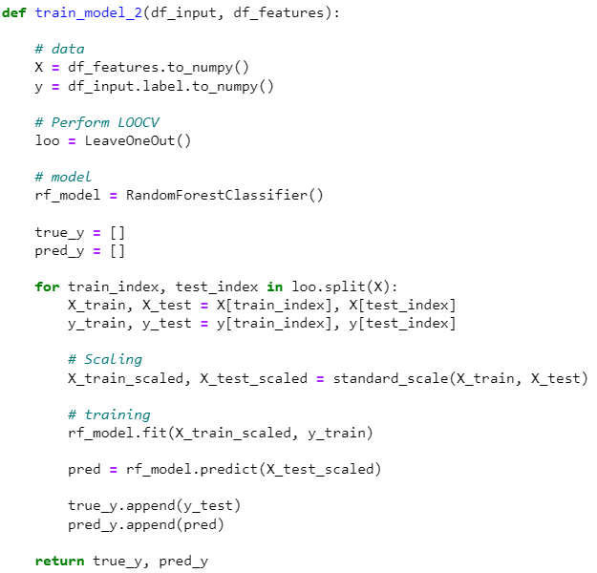
Model training functions
Random Forest Classifier

Slide 18
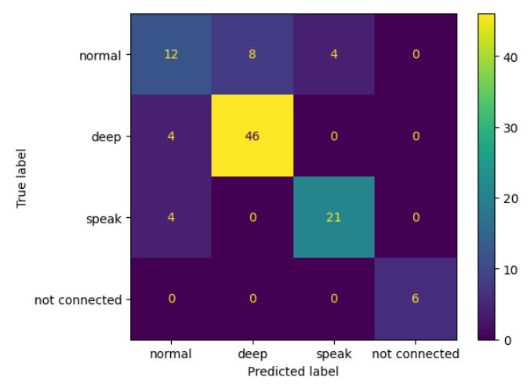
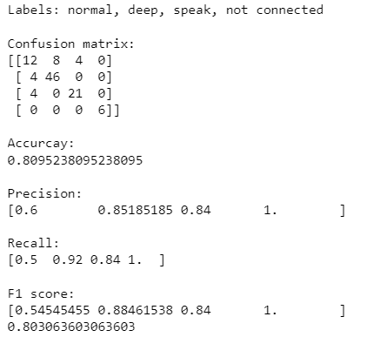
Model training functions
RF Classifier - Results

Slide 19
Thank you

